Slide 2
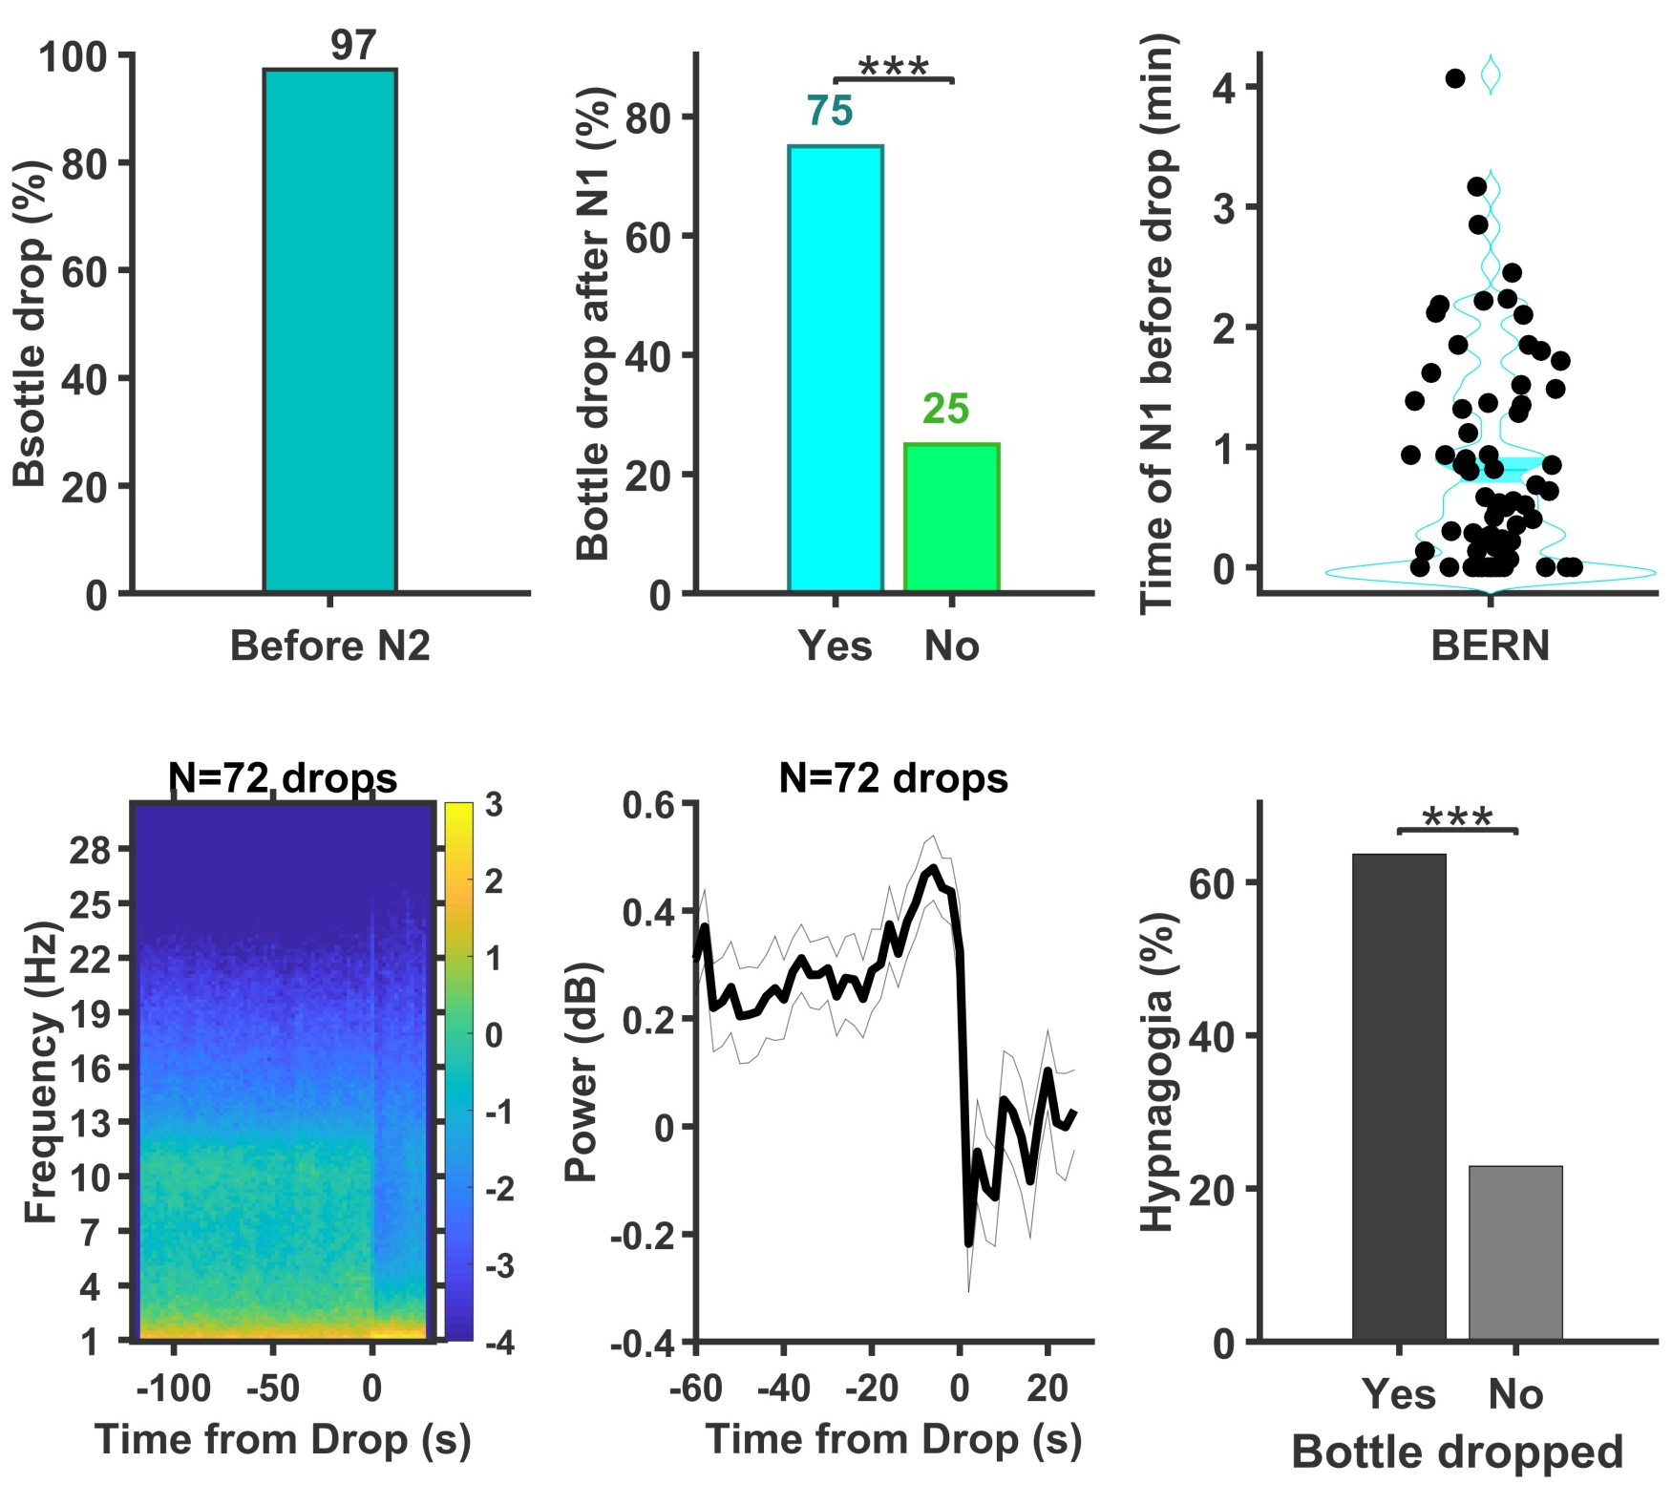
A
B
C
D
E
F

Slide 3
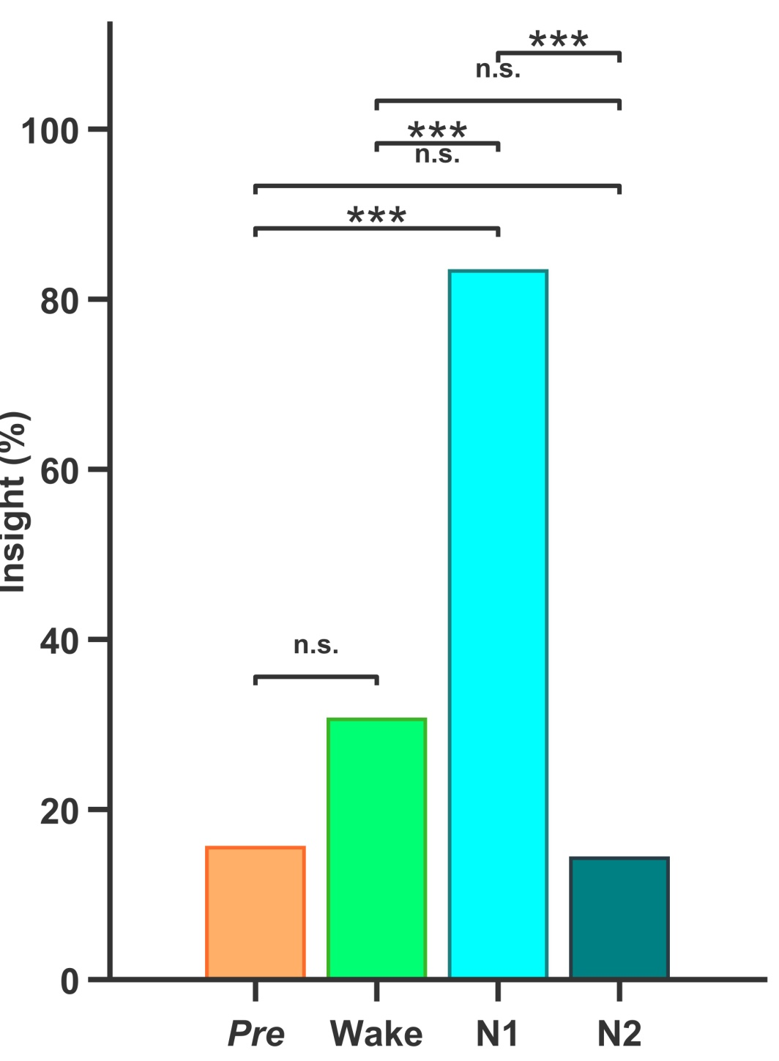
A
B
C

Slide 4
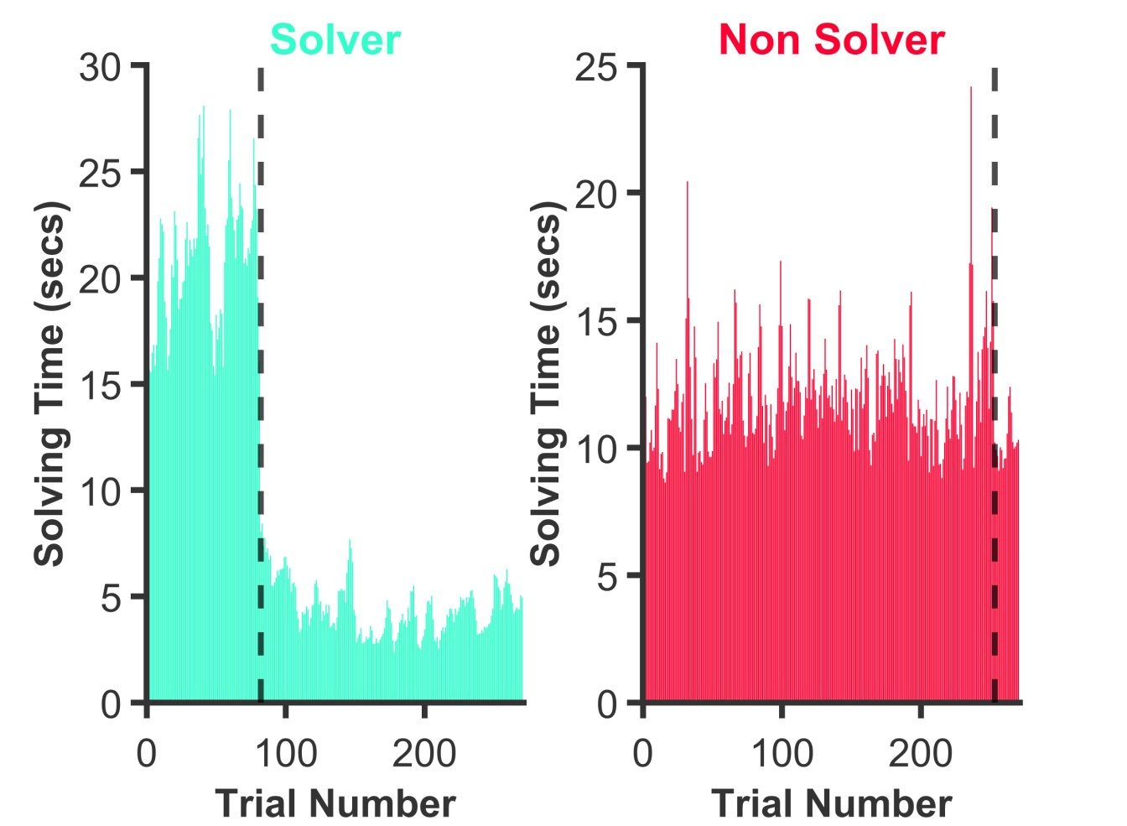
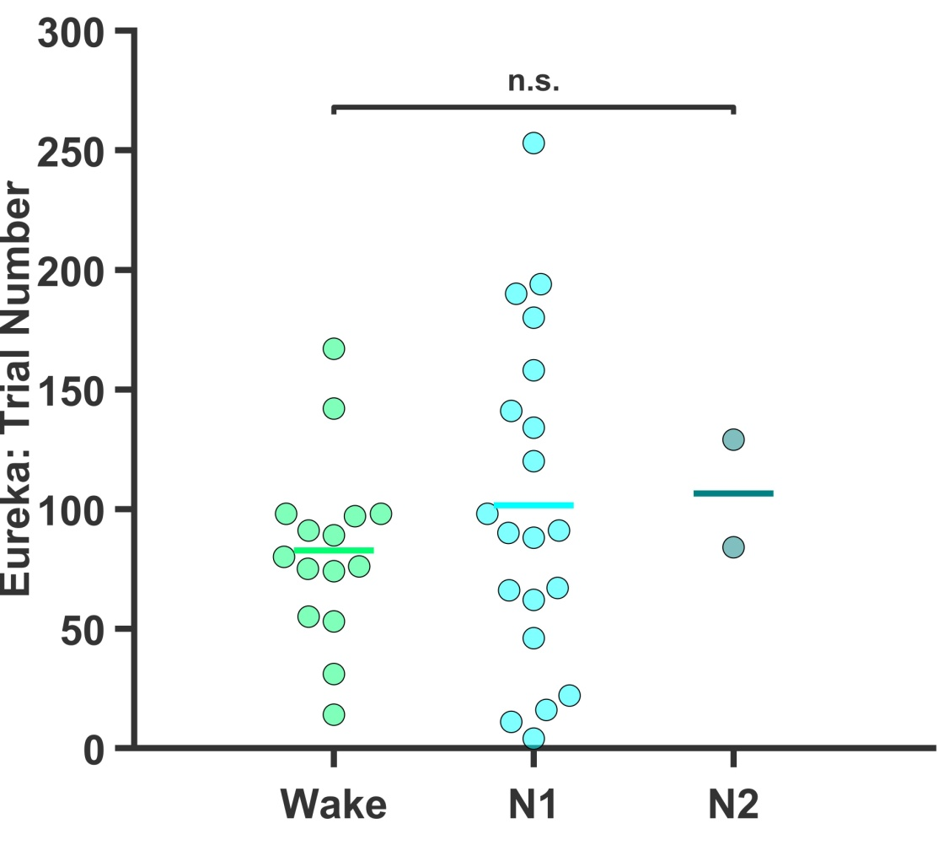
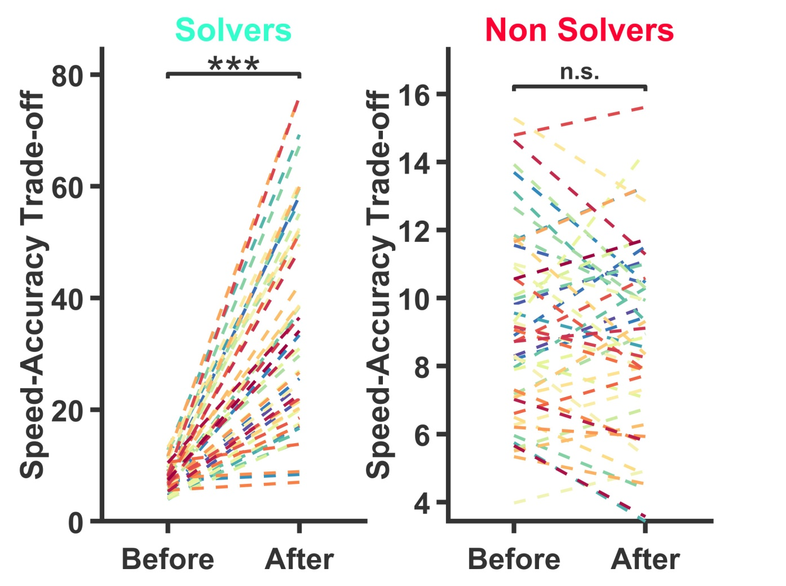
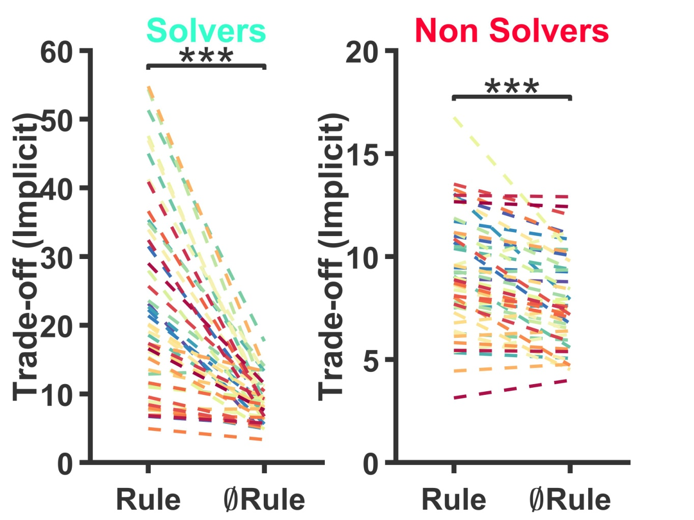
A
B
C
D

Slide 5
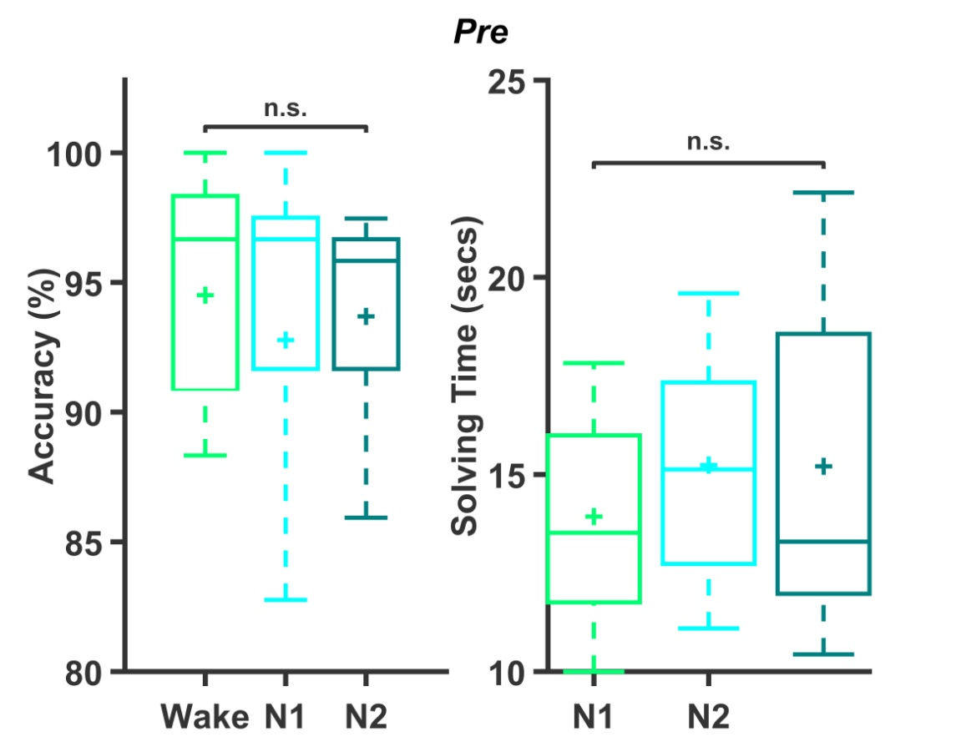
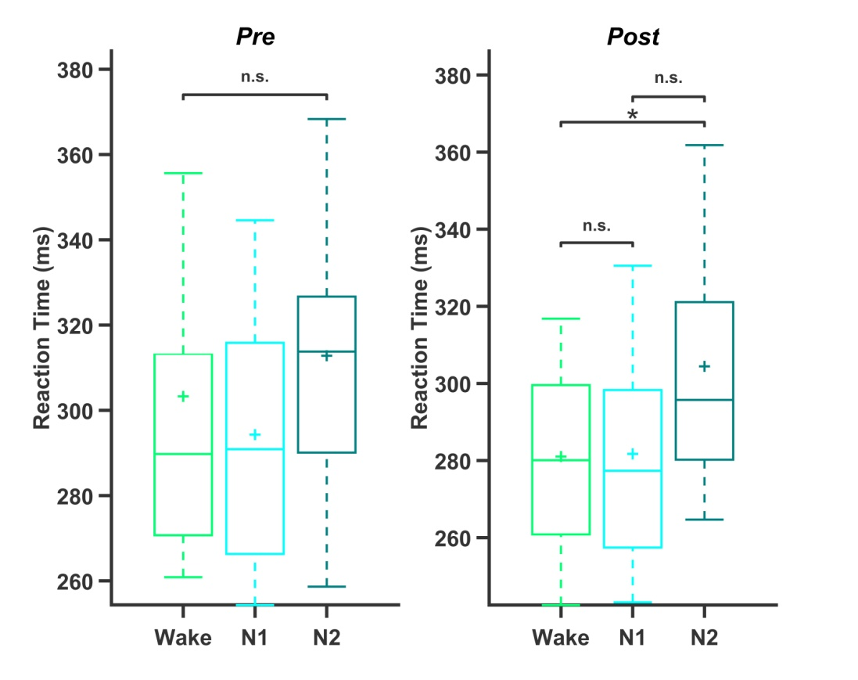
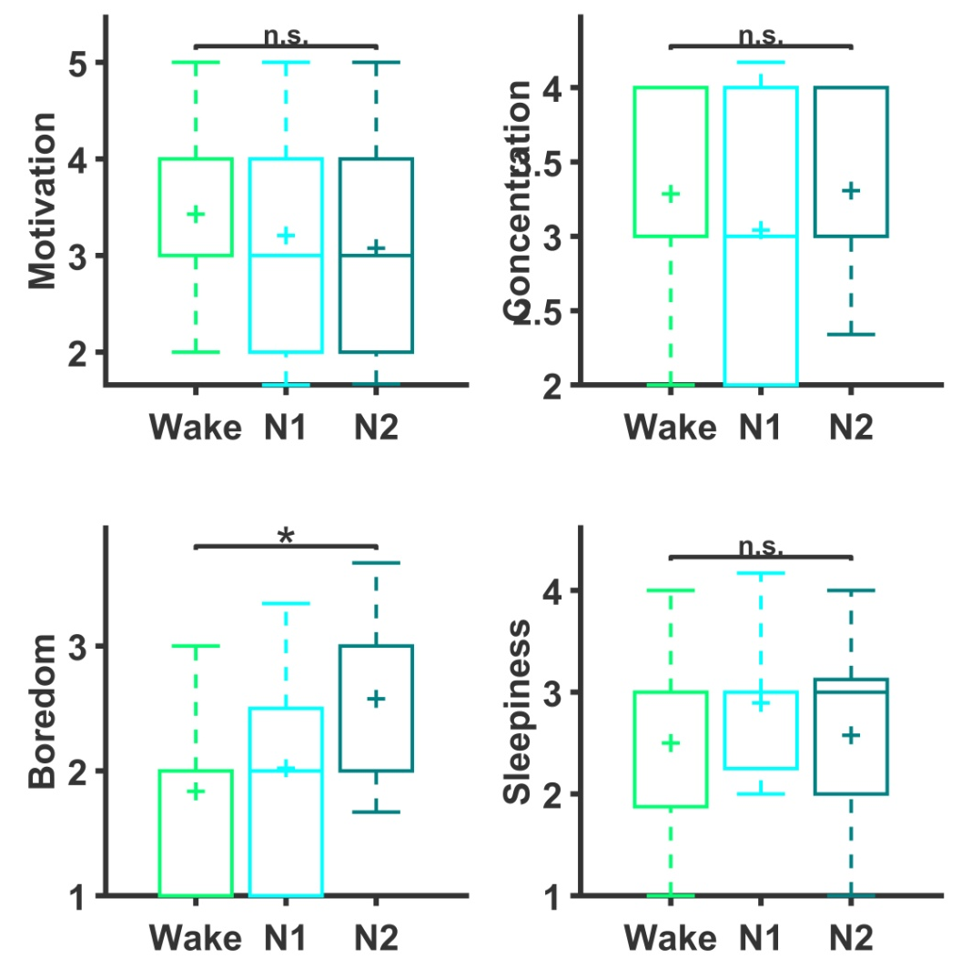
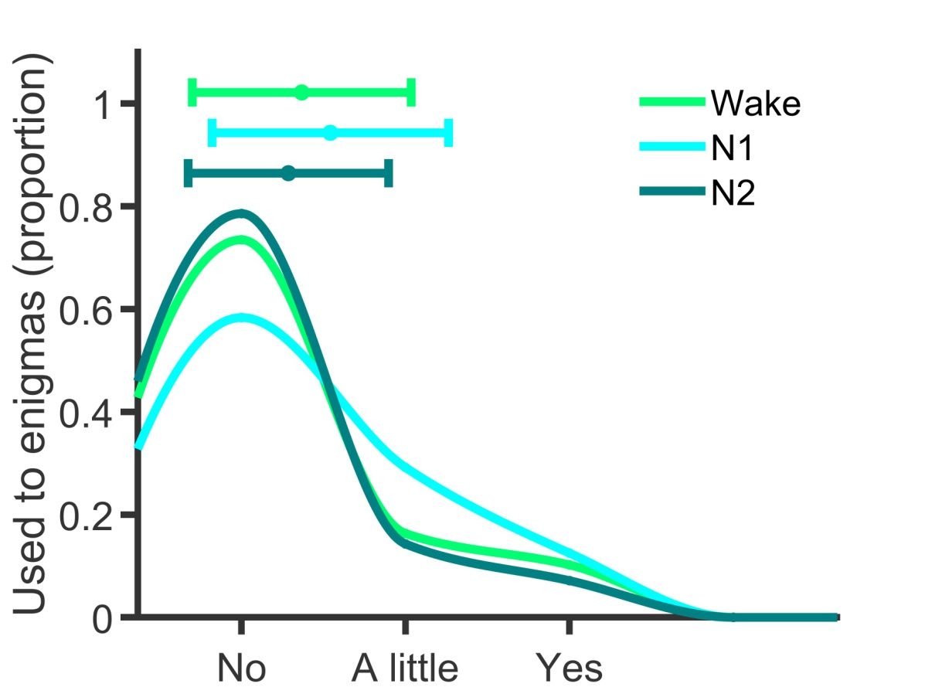
A
B
C
D

Slide 6
A
B
Pre phase
2 blocks
Break
20 min
Post phase
11 blocks
C
Notes:
FP1, C3, O1, EOG G, EOG D, EMG
https://convertimage.net/online-photo-effects/online-photo-drawing-sketch.asp?i=20201217-151057-qbcwh

Slide 7
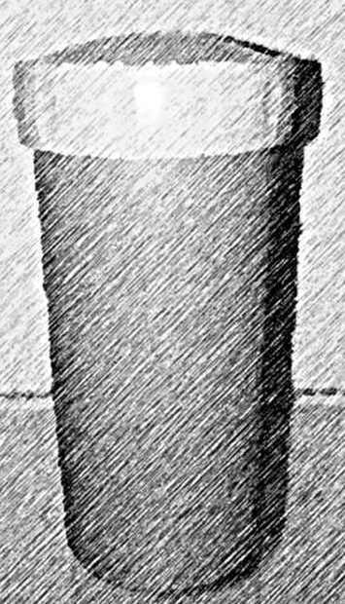
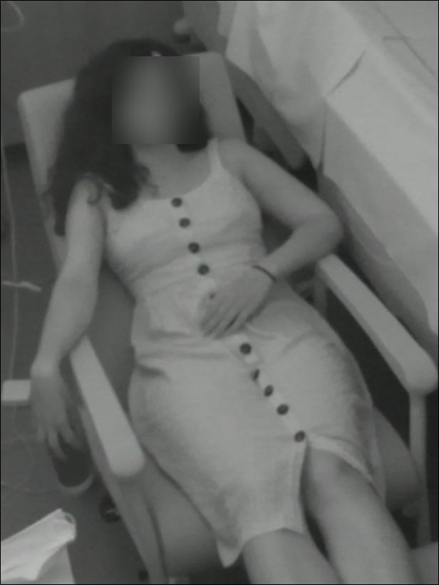
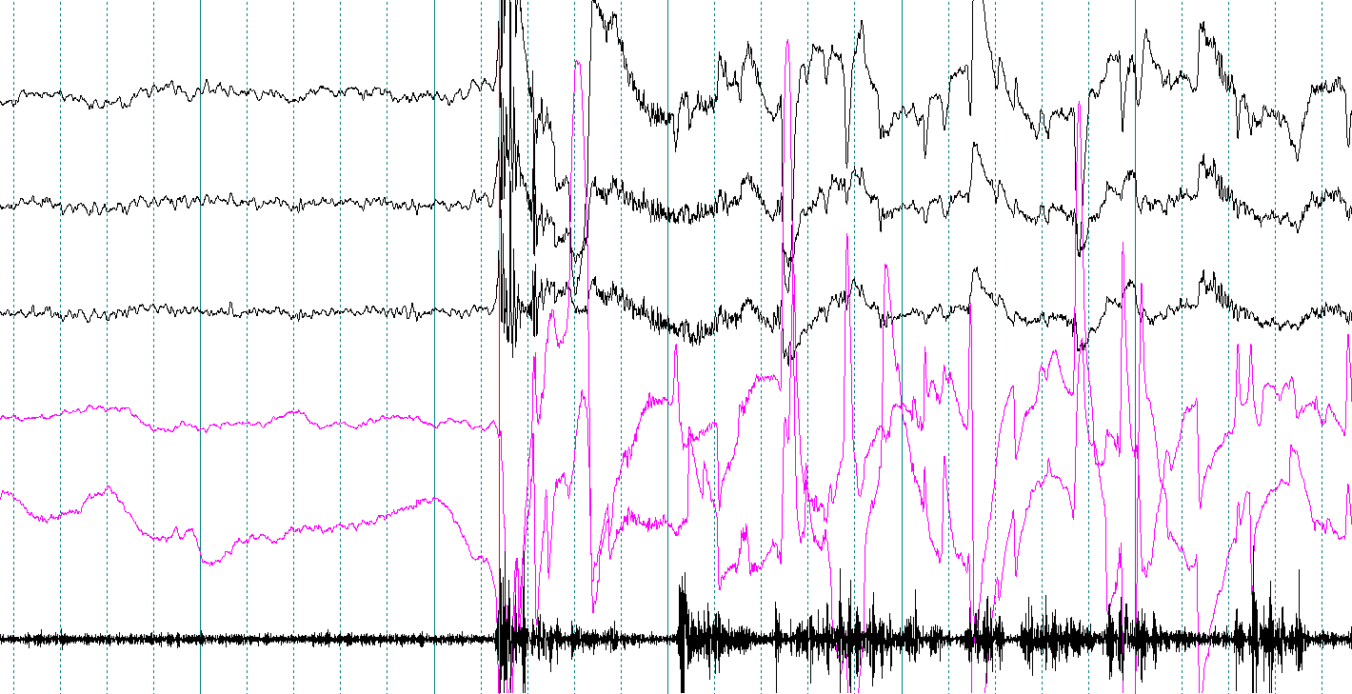
FP1
C3
N1
01
EOG G
EOG D
EMG
Reported hypnagogia

